Slide 1
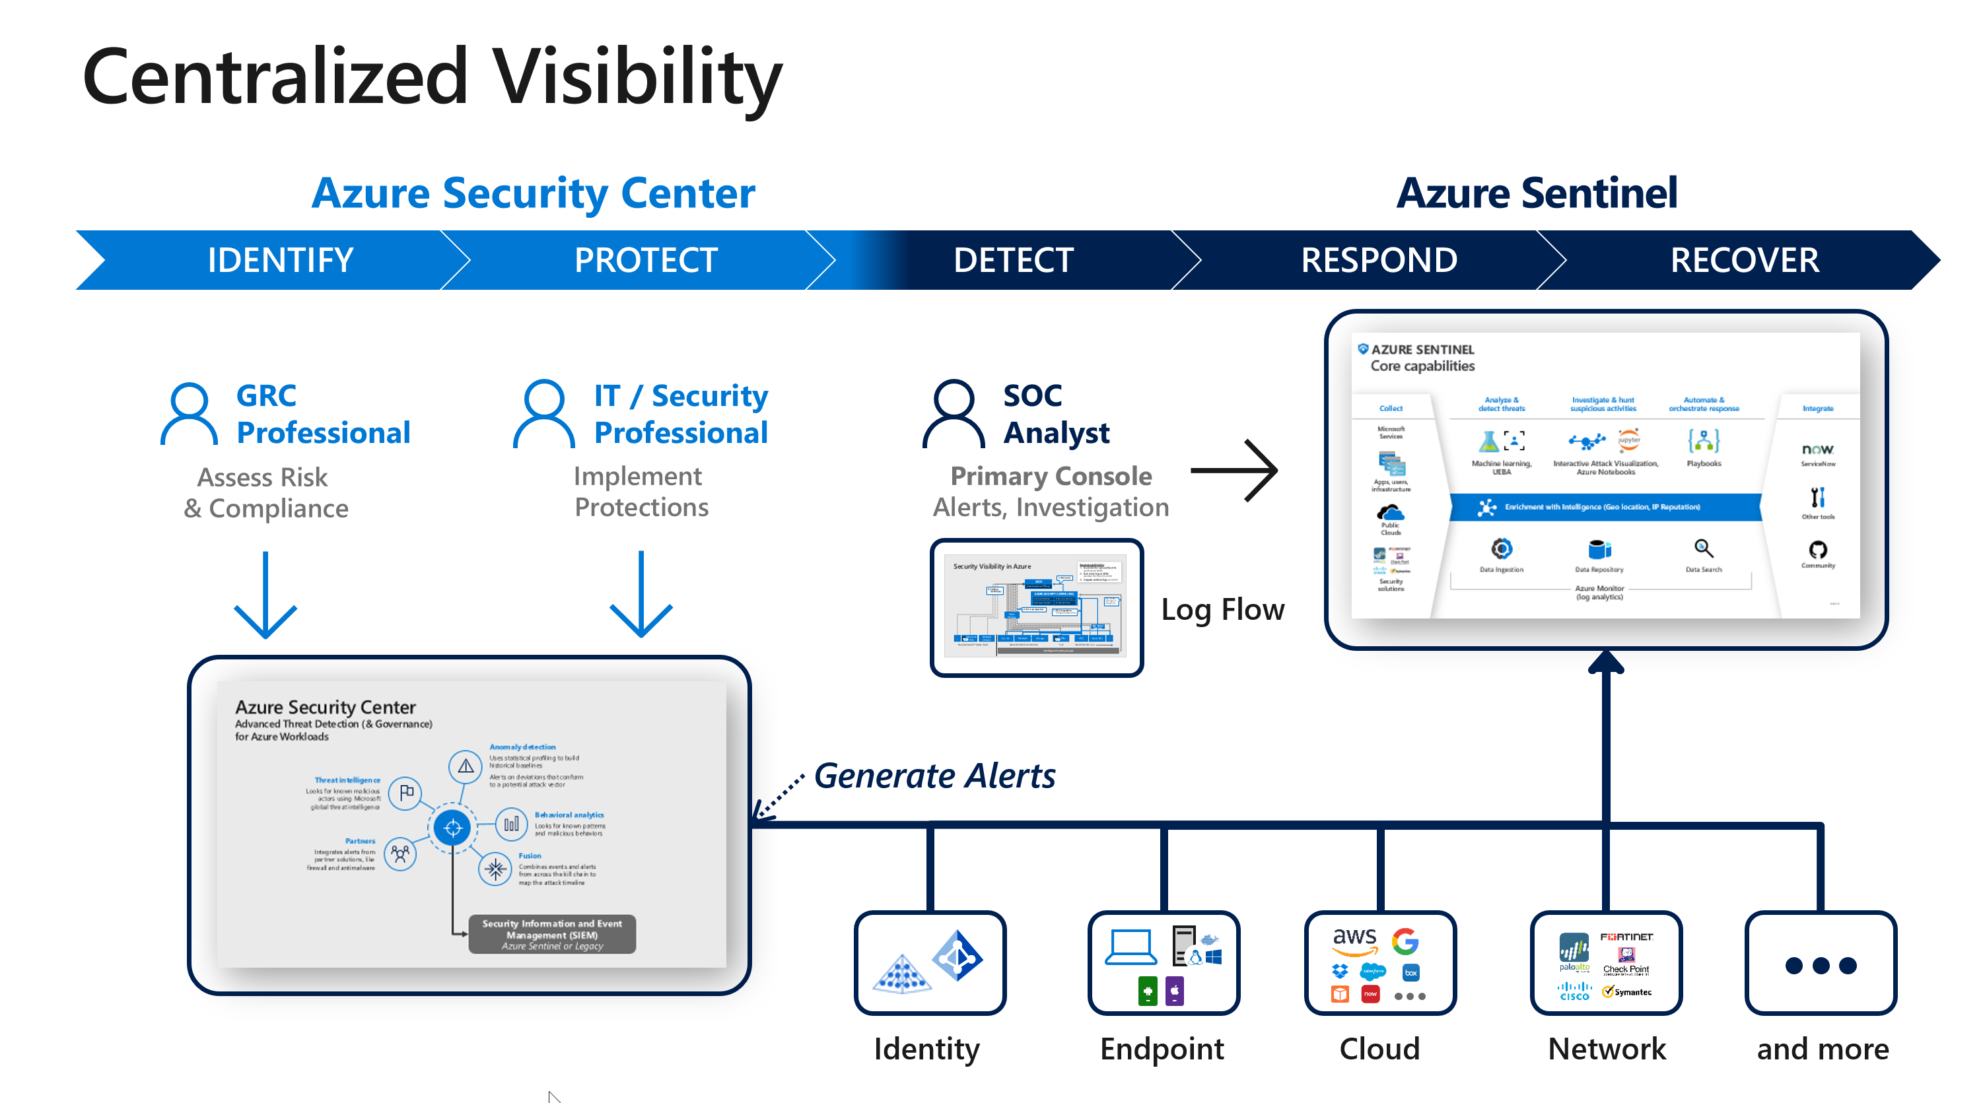
Ingesting Data
Connecting Amazon GuardDuty to Microsoft Sentinel + API Solution
Notes:
Hello, welcome to my presentation. Today I will be conducting a live demonstration testing out the Microsoft Sentinel’s AWS S3 data connector. The connector will be able to pipe alert data from Amazon Web Services GuardDuty to Microsoft Sentinel. I will also demonstrate sending custom log data through Microsoft Sentinel’s HTTP API Collector to the Microsoft Azure Log Analytics Workspace. Just a note, the presentation may be a little shorter, but this is to compensate for the live demonstration.

Slide 2

Challenges For official documentation
Automated Script
Manual Setup
Workbooks
Notes:
Unfortunately, using the built-in data connector come with many challenges. First, I attempted the manual setup. I do not recommend this, make sure to use the automated script. The permissions on AWS IAM were incredibly hard to understand and I had many configuration errors. However, with the automated script I had only one problem. I had to figure out for the first time to use user IAM permissions on AWS. I had to create a separate user account so that I could configure my AWS user credentials on my EC2 instance. From there, the automated script took care of the rest. There was also one more challenge, but this time it appeared on Microsoft Sentinel. When I generated some fake data from GuardDuty, Microsoft Sentinel did not automatically categorize it. The data was hidden under a tab called “other.” I had to use Workbooks which are custom scripts to display data and enable the AWS S3 workbook before the data showed in my overview of Microsoft Sentinel.

Slide 3

Challenges for api
API Usefulness
API oAuth
API Scalability
Notes:
Once more, unfortunately, using the HTTP API Data Collector had challenges as well. First, the API is bare-bones meaning that it comes with limited functionality. Later in the presentation I will show everyone the code and how it works. I had to use ConfigParser so I do not leak my credentials. Also, the official documentation kept talking about creating an oAuth token to authorize my EC2 instance, but this is not the case. I could use a primary or secondary key instead. This caused confusion because I thought that I needed to custom code a session authorizer that would request an oAuth token and capture it using a HTTPD webserver like I created for my stock bot, and I did not have time to spend three weeks on this project. Luckily, this was not the case. Then it came time to finally test this API, but I noticed that it is not so functional or scalable as it is right now. The data to send is in a raw JSON format in the script itself. If another program spits out JSON data to a file, I will need to code in a quick fix to take input from a file and then send that data. I will explain all of this in more detail when I show the raw code.

Slide 4
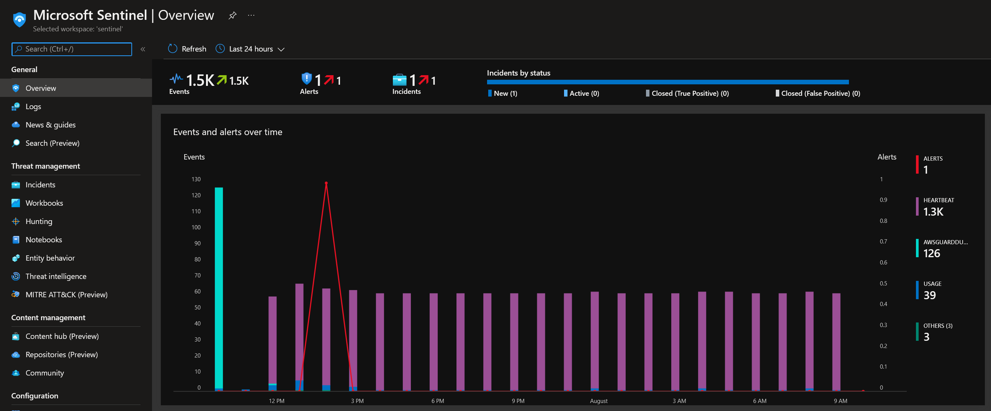
Supported Data Connector
Notes:
After setting up the connections, I was very easily able to get data from GuardDuty to Microsoft Sentinel. The data connector was queried every 15 minutes or queried if there was an urgent update. As far as I can tell, everything is working without a hitch and Microsoft Sentinel is continuously categorizing and monitoring GuardDuty’s output.

Slide 5
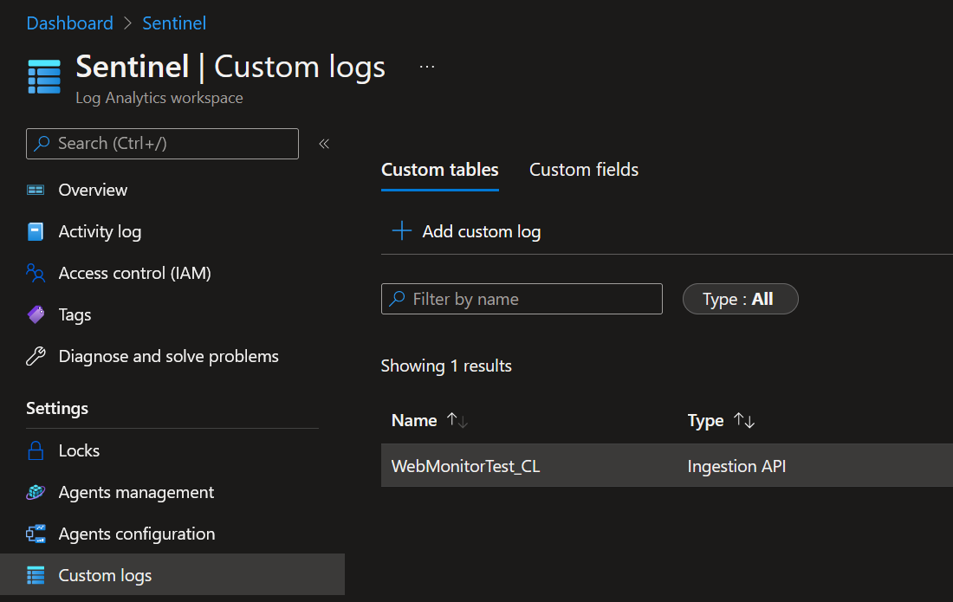

Api data connector
Notes:
As for the API data connector, this works without a hitch as well. I can query data from a JSON format and send it to the custom logs tab in Microsoft Sentinel. This custom data does show on the main dashboard, however, it will appear under “other.”

Slide 6

Api costom coding
Notes:
Now while the API is working correctly, it has limited functionality. I was not able to take input from a JSON file or as an output from another program and send it to Microsoft Sentinel. To obtain this functionality, I would need to add it. Luckily, I did, I added that whenever the API is called, it will open up a pre-defined document and send that data to Microsoft Sentinel. This is to make it easier if a program outputs some type of threat data to a file and then call the API to upload it in real-time.

Slide 7
Action
Live Demonstration
Generate Fake Data
Send Fake Data Through API
Notes:
Now, it is time for the live demonstration, I have everything setup and ready to test. I will first be testing the S3 Data Connector, I will generate some fake data from AWS. You will see in live-time the data showing up on Microsoft Sentinel. Then, I will test the HTTP Data Collector API. I will simulate that a program has just found a virus and it is calling the API to send the data to Microsoft Sentinel.

Slide 8

Conclusion
Reliable
Fast
Protected/Safe
Notes:
In conclusion, both methods of sending data to Microsoft Sentinel are reliable, fast and protected. The setups are a bit hard at first, but once everything is configured it will work flawlessly.

Slide 9

Next weeks ideas
VECTRA
Notes:
For next weeks ideas I want to investigate VECTRA, an AI based threat detection engine. I have researched this company a bit so far and I believe that this is a great program to look at. From what I can see, this blows all other AI detection programs out of the water. I’m also curious about connecting this platform to Microsoft Sentinel because there is a data connector for it. Of course, I will give a demonstration for connecting VECTRA to Microsoft Sentinel as well as a live test.

Slide 10
references

